Slide 1
The Technology
Value Stream
Sarah Ewing 10/25/2024 Module 1.2 Assignment

Slide 2
What is a Value Stream?
A value stream is the sequence of activities necessary to deliver a product, service or experience to a customer, internal or external. (Gartner, 2024)

Slide 3
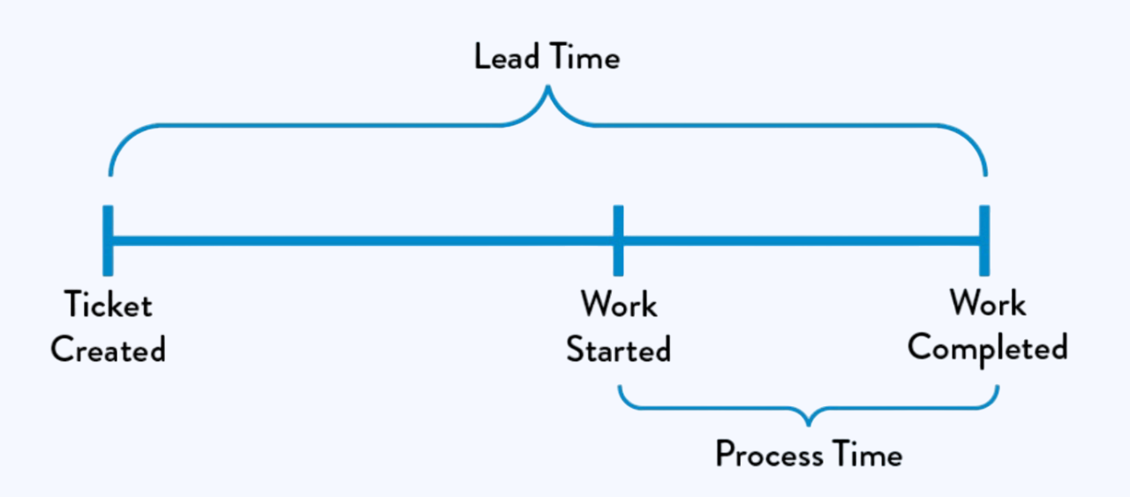
Lead Time vs Process Time
Lead time begins when a request is made by the customer and ends when the request is fulfilled. Process time starts when work begins on the request and ends when the work is completed.
(Source: Kim et. al. The DevOps Handbook, 2021.)

Slide 4
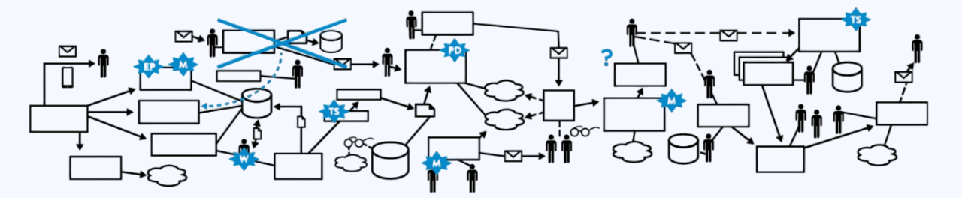
The Common Scenario
Large organizations often have lengthy deployment lead times due to complex systems, manual processes, and limited testing resources. This leads to code conflicts and delays in delivering value to customers.
(Source: Damon Edwards, “DevOps Kaizen,” 2015.)

Slide 5
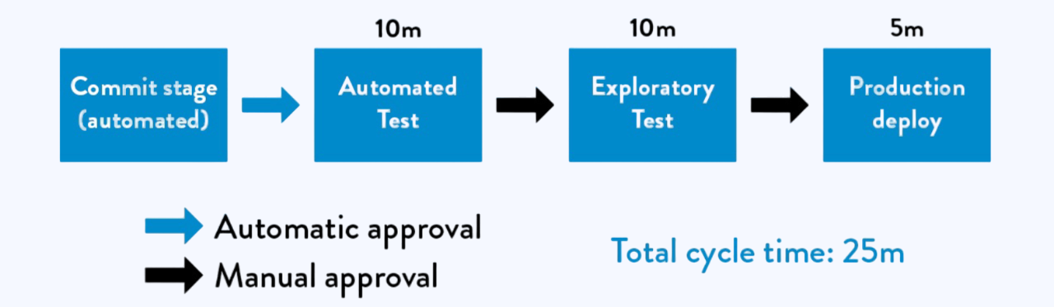
Our DevOps Ideal
(Source: Kim et. al. The DevOps Handbook, 2021.)
DevOps aims for rapid feedback, enabling developers to quickly implement, test and deploy their code. This is achieved through frequent code commits, automated testing, and continuous deployment. By breaking down systems into smaller, modular components, teams can work autonomously, reducing the risk of major disruptions. This approach significantly shortens deployment lead times, often to minutes or hours.

Slide 6
Value Stream Metrics
Flow Distribution
Flow Velocity
Flow Time
The proportion of each flow item within a value stream across time
Number of flow items done in a given time
Time elapsed when a flow item enters the value stream to when it is released to the customer
Flow Load
Flow Efficiency
Number of items with flow state as active or waiting
The proportion of flow items are actively worked on to the total time elapsed
(Source: https://www.blueprintsys.com/blog/value-stream-mapping)

Slide 7
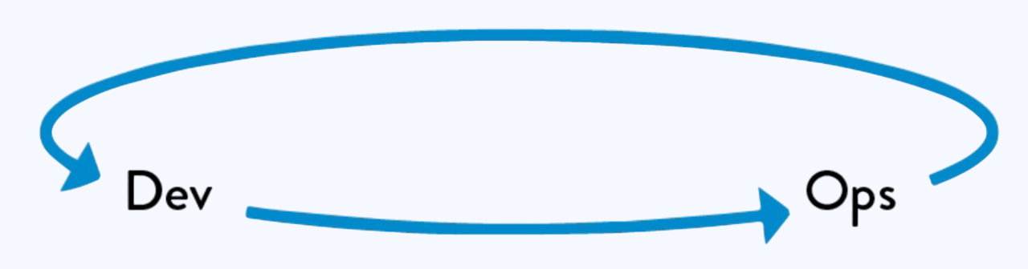
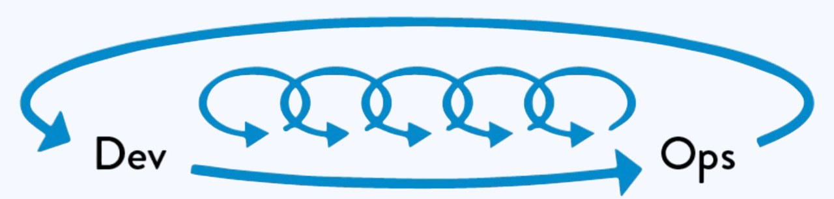
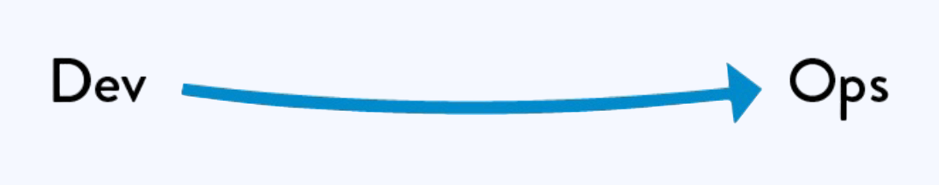
The Three Ways
All DevOps behaviors and patterns are derived from these underpinning principles
Flow/System Thinking
Amplify Feedback Loops
Culture of Continual Experimentation and Learning
Make work visible
Reduce batch sizes
Prevent defects from being passed downstream
Optimize for global goals
Fast and constant feedback
Amplify feedback to prevent problems
Problems found and fixed quickly
Experiment, take risks, learn from failure
Repetition and practice for mastery
Ongoing improvement and resilience
(Source: Kim et. al. The DevOps Handbook, 2021.)

Slide 8
Sources
https://www.gartner.com/en/information-technology/glossary/value-stream
Kim, Gene, et al. The Devops Handbook: How to Create World-Class Agility, Reliability, & Security in Technology Organizations. IT Revolution Press, 2021.
http://www.slideshare.net/dev2ops/dev-ops-kaizen-damon-edwards
https://www.blueprintsys.com/blog/value-stream-mapping
https://itrevolution.com/articles/the-three-ways-principles-underpinning-devops/

